Slide 1
The 48 Hour Investment Process
Ben claremon
Principal & Portfolio Manager
Cove Street Capital
April 2021

Slide 2
Safe Harbor
The opinions expressed herein are those of Cove Street Capital, LLC and are subject to change without notice. Past performance is not a guarantee or indicator of future results. Consider the investment objectives, risks and expenses before investing.
The information in this presentation should not be considered as a recommendation to buy or sell any particular security and should not be considered as investment advice of any kind. You should not assume that the security discussed in this report is or will be profitable, or references we make in the future will be profitable or equal the performance of the security discussed in this presentation. The report is based on data obtained from sources believed to be reliable but is not guaranteed as being accurate and does not purport to be a complete summary of the available data.
Cove Street Capital, LLC is a registered investment adviser. More information about us is located in our ADV Part 2, which is on our website or upon request; http://covestreetcapital.com/faq/

Slide 3
Presentation Overview*
Why this matters to YOU
Things to do BEFORE you start researching
Checklist on how to get up to speed quickly:
Business
Value
People
How to think about a recommendation
Other avenues available if you have more time
Key takeaways
Q&A
Notes:
*Text heavy presentation but can be used as a checklist

Slide 4
Presenter Biography
Ben Claremon
Ben Claremon joined Cove Street in 2011 as a research analyst. He also serves as a Co-Portfolio Manager for our Classic Value | Small Cap Plus strategy. Previously he worked as an equity analyst on both the long and the short side for hedge funds Blue Ram Capital and Right Wall Capital in New York, and interned at West Coast Asset Management in Santa Barbara. Prior to that, he spent four years with a family commercial real estate finance and management business. Mr. Claremon was also the proprietor of the value investing blog, The Inoculated Investor. His background includes an MBA from the UCLA Anderson School of Management and a BS in Economics from the University of Pennsylvania’s Wharton School.

Slide 5
Investment Philosophy
Classic fundamental, research-driven value investing
Concentrate on best ideas
Buffett vs. Graham framework
Think and act long-term
Mathematics of compounding
Less is more
Key investment questions:
Is this a high return company that is getting more valuable each day?
Is this company run by honest people who understand capital allocation?
Is the stock undervalued based on conservative assumptions about the future?

Slide 6
Why are we here?
If you are interviewing for a job in investment management, you might be asked to turn around a stock in 48 hours
Real world example: FPA and Big Lots (BIG)
Even if you are going into i-banking, having an expedited process will be helpful
Good way to filter out what you shouldn’t spend time on at work or for your own PA
You will be honing your process the rest of your career
Develop the ability to quickly figure out what not to spend time on
This truncated process is not the only way—other investors will have a different process
But there should be elements you can take away

Slide 7
But, before you even start…
What is the purpose of this process?
Job interview
New project at work
Looking for investments for your PA
Helping family/friend/spouse understand a potential employer or investment
What is your own personal objective?
Get a job, impress boss/colleagues, improve your process, make $, etc.
What is your boss/potential employer looking for?

Slide 8
Poll # 1
What is your desired job/industry post-graduation?
A) Investment management
B) Investment banking
C) Consulting
D) Other

Slide 9
Job interview scenario
What is the firm/fund looking for?
Unlikely to make an investment decision based on your work
Not looking for a full analysis/model/recommendation
If they are looking for a recommendation => red flag?
They want to understand your process and HOW you think about investing
Do you have the skills/knowledge/passion to contribute?
Do you think like an analyst or a PM?
IMHO: Always put on the PM hat
Is there anything special or unique about you?
Business, value, people is a great framework from which to start
Thoughtfulness > Precision; Curiosity > Certainty
Think about what else you would do if you had more time
Be creative: call IR or message someone on LinkedIn--why not?

Slide 10
New project at work scenario
What is your boss looking for?
Not looking for a full analysis/model/recommendation
If they are looking for a recommendation => red flag?
Should we spend more time on this company?
Is this a Buffett or a Graham stock?
Do we have the internal ability to develop an edge?
Is this the kind/type of company we invest in?
What other research outlets are there for us?
Want you to think like a PM—how would this stock fit into a portfolio?
Business, value, people is a great framework from which to start
Thoughtfulness > Precision; Curiosity > Certainty

Slide 11
Poll # 2
On which of these topics do you think you should start your analysis?
A) People
B) Value
C) Business

Slide 12
General process advice
Take NOTES as you dig and read! (Don’t be lazy)
Start a Word doc or use Slack
You will want to refer to things you come across later and you don’t want to rely on your memory
Copy and paste valuable charts and graphs as well
Write down questions that come up as you go
Think about the 4 key variables that will determine the success of the investment
Have a game plan that involves a checklist
This presentation + assessing management presentation = good start
Get access to a high-quality data site
Don’t go down unnecessary rabbit holes
Recognize that you won’t know everything or understand every detail
Always keep in mind: B, V, P

Slide 13
BUSINESS

Slide 14
Assessing the Business
There are many variables/factors you can focus on but here are 10 things you can start with:
How does the company make money?
What are the company’s products and services?
Who are its main customers and competitors?
Where does it have to invest over time?
Does it generate good margins and returns?
What are the growth opportunities? End markets growing?
Where is there room to become more profitable/efficient?
How does this business finance itself?
Does this company have a sustainable competitive advantage that allows for either lower costs or consistent pricing power?
What are the main threats and risks to the business?

Slide 15
Poll # 3
Which document or source is best to start with when first looking at a company?
A) Sell side report
B) Company presentation
C) Proxy
D) 10-K/Annual Report

Slide 16
Assessing the Business
Checklist of where to start to answer these questions:
10-K/Annual Report: almost always the best place to start
Company overview section
Products/services
Differentiation and strategy
End markets
Competitors
Customers
Risk Factors: mostly legalese but look for outliers
Management Discussion and Analysis (MD&A): how has the business performed recently?
Financial Statements
Cash flow statement is king
Notes
Don’t worry about things such as revenue recognition or goodwill accounting
Chairman or CEO Letter: always worth reading for context
Company conference presentations: transcripts and PowerPoints
Company website: can have a treasure trove of information

Slide 17
Assessing the Business
Where else to go to answer the 10 questions:
Sell-side initiation report available?
Can offer a very helpful overview
But beware inherent bias and of “price targets”
Recent quarterly conference call transcripts
Other web-based content:
Industry primers
Write-ups from other investors (e.g. Seeking Alpha or Value Investors Club)
Proceed with caution
Industry blogs and trade magazines

Slide 18
Assessing the Business
So, you have done an initial dive but now what?
Go back through your notes
This is how you start to create a narrative
See if you can answer the 10 questions
If you can, write down your answers
If not, find new sources to get answers
Time to move from information gathering to critical analysis and skepticism

Slide 19
Assessing the Business
You need to make a call on business “quality”
Margin and return analysis: ROIC > WACC?
If yes → by how much? If no → why would it get better?
Margins and returns versus closest comps (more on next slide)
Barriers to entry, moat, switching costs, network effects, capital intensity
Buffett versus Graham?
C-PEST analysis
Climate, political, economic, social, technological threats and opportunities
Incremental ROIC high as well?
Secular tailwinds or threats? Cyclical issues?
Can you say for sure the business is getting more valuable each day?
If you could not trade the stock, would you be happy to own it over the next 3 years? 5 years? 10 years?
Ignoring valuation is this a stock you WANT TO OWN?

Slide 20
Assessing the Business
Is ROIC >WACC?
There are a lot of ways to calculate returns
ROE
Return on tangible capital
NOPAT/Capital Employed (Cove Street’s preferred ROIC)
ROA
Do you include intangibles and goodwill or not?
Simple advice:
Use multiple metrics and do noy rely on just one
Try to figure out what is appropriate for the industry
If the returns are close to WACC, err on the side of caution
Assume it is a Graham until proven otherwise
Look deeply at industry structure
More consolidated → likely higher margins/returns
Less consolidated → potential room for more consolidation
How ripe for disruption is the industry as a whole?

Slide 21
Assessing the Business
Margins and returns versus closest comps
Compare segment by segment if you can (see below)
Otherwise, compare margins and returns at the company-level

Slide 22
Poll # 4
How important is the balance sheet and leverage when first looking at a company?
Not so much, the business is WAY more important
Very important because leverage can destroy a business
Valuation is really what VALUE investors should focus on

Slide 23
Assessing the Business
Quick Balance Sheet Review
A few key metrics:
Net debt to EBITDA
EBITDA/Interest Expense
(EBITDA-CAPEX)/Interest Expense
Does the business generate cash consistently?
Nearest maturities
Covenants
Other funding requirements: dividends, buyback, M&A, legal settlements, environmental costs, etc.
Every company and industry is different
So, the B/S risk is dependent and subjective

Slide 24
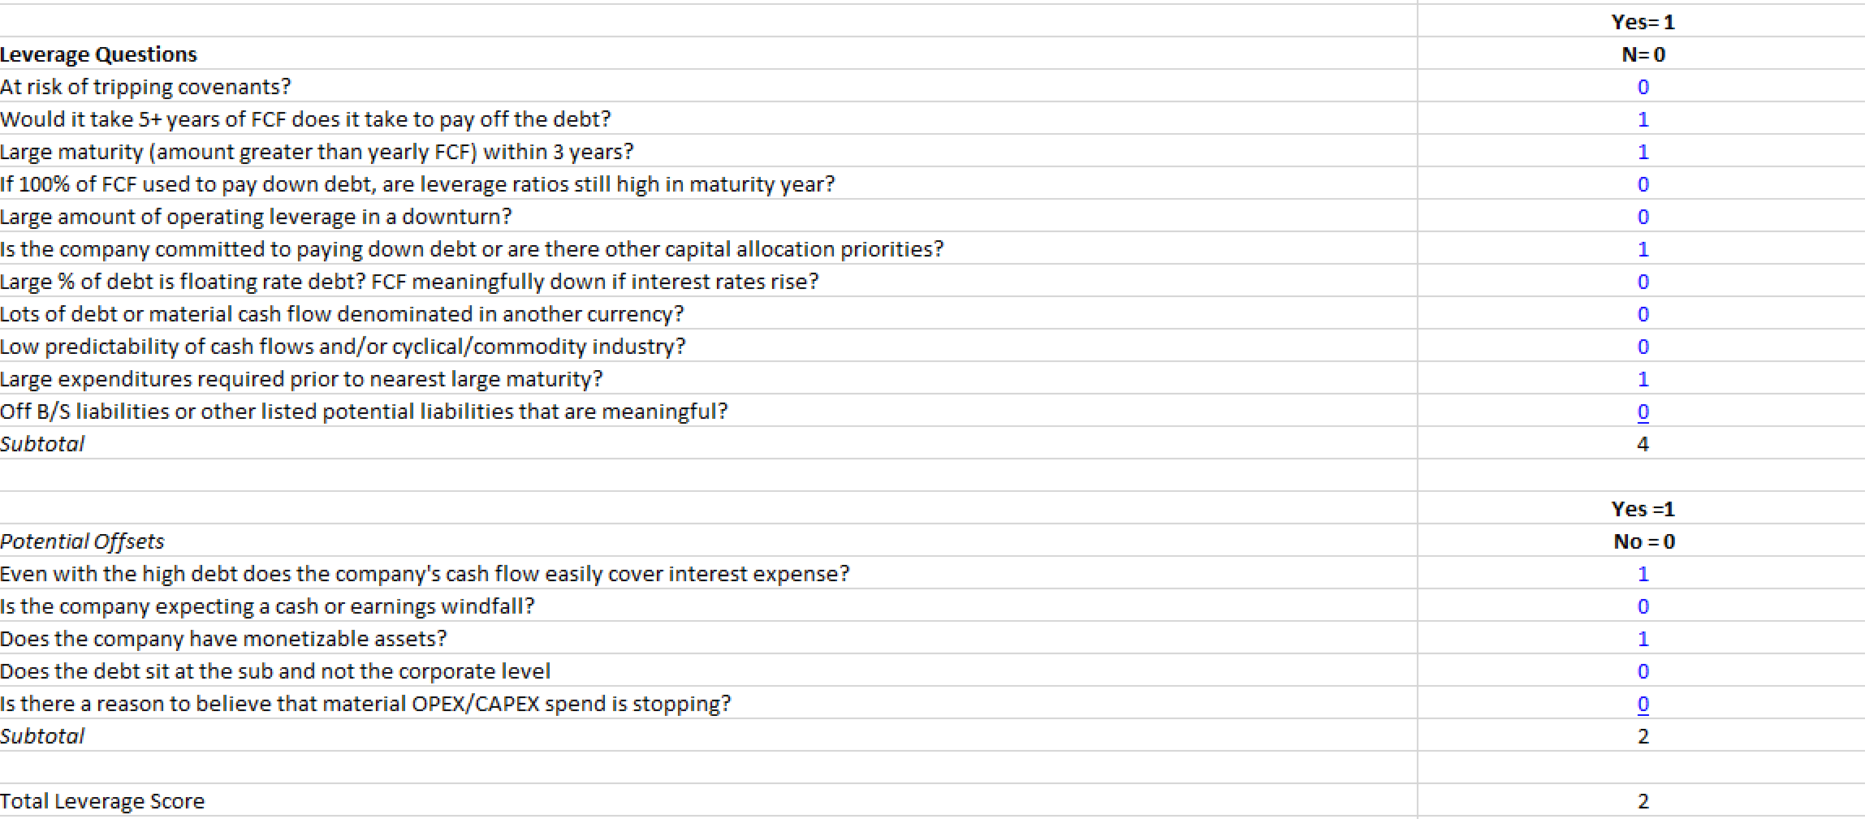
Assessing the Business
Ben’s Proprietary Debt Score
Make a call about the risk of the B/S

Slide 25
VALUE

Slide 26
Why is valuation so important
As an investor, all you can control is:
Your due diligence process
The price you pay
Academic research says “valuation really matters when it comes to future returns”
Core skill of being an equity analyst
Allows you to employ creativity
Building consistency is key to a good process

Slide 27
Poll # 5
What valuation metric should you be most focused on?
P/E ratio
EV/EBITDA
Sum of the parts
DCF
All of the above

Slide 28
Key Valuation Techniques
DCF
Historical Multiples Analysis
SOTP
Private Market Value
TRIANGULATE!!
You want multiple metrics that suggest that the stock is trading below intrinsic value
But no bell goes off when you hit a stock’s intrinsic value

Slide 29
Discounted Cash Flow Analysis (DCF)
The value of ANY company is equal to the present value of future cash flows
The difficulty is properly understanding what the future will look like
This is why you have to perform deep diligence on the business:
Competitive advantage
Total addressable market
Incremental returns on capital
Margin/return enhancement opportunities
Capital allocation avenues
Garbage in= garbage out
Any stock can be cheap or expensive based on assumptions
Multiples are simply short hands for a DCF
Great presentation from NYU professor on marrying the narrative and model: http://people.stern.nyu.edu/adamodar/pdfiles/country/narrative&numbers.pdf

Slide 30
DCF (cont.)
Cove Street’s Conservative DCF Assumptions
Risk free rate = 5%
Far higher than current 30 Year UST
Think of WACC as a minimum level of return you would accept as an equity investor
Long term market returns of 6-7% so acceptable WACC > market returns
We are not alone– Joel Greenblatt:
https://www.theinvestorspodcast.com/episodes/common-sense-investing-w-joel-greenblatt/
Terminal growth rate = 0%
Modest growth expectations years 5 to 10

Slide 31
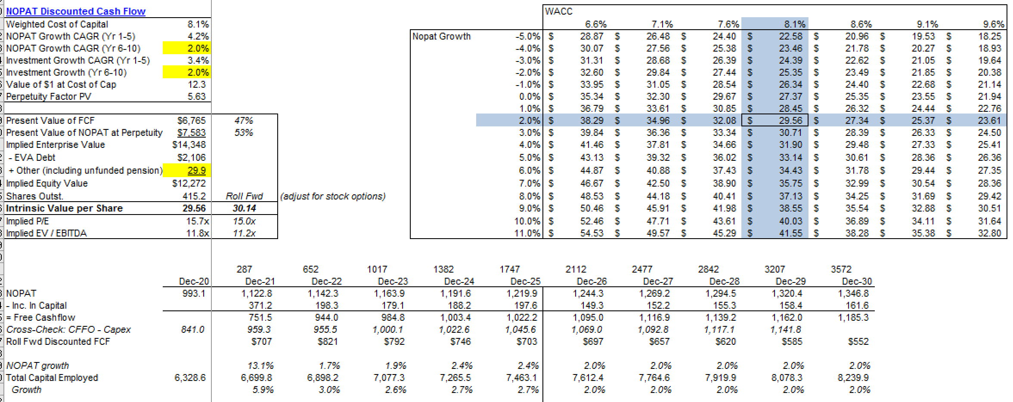
DCF (cont.)
DCF Example: Western Union (WU)
Stock Price: $24.45

Slide 32
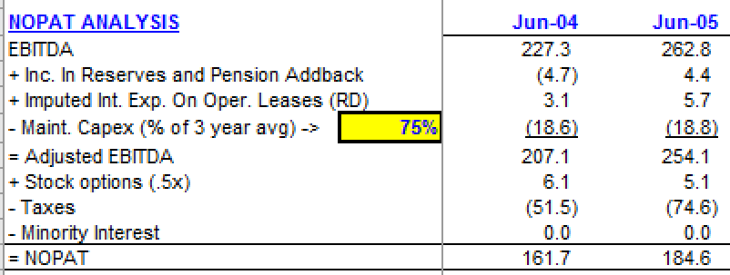
Quick and Dirty Model
Income Statement
Revenue
Ideally driven by a metric such as subscribers
Forecast out subs and revenue/sub
Gross margins
Tells you a lot about the quality of the business
Operating Income and Operating Margin
EBITDA (necessary for PMV and SOTP values) and EBITDA%
Tax Rate
EPS
Cash Flow Statement
D&A
Changes in working capital
CAPEX and Maintenance CAPEX
Option expense
These are the building blocks to get NOPAT

Slide 33
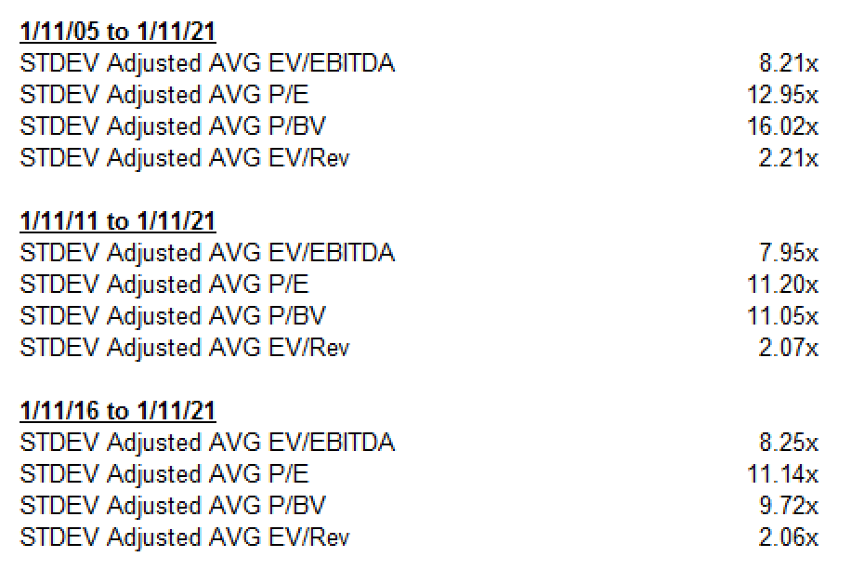
Historical Multiples
We use Capital IQ to determine the standard deviation adjusted average multiples for every company
5, 10, 15 year average if available
Apply the chosen multiple to 3 year out EV/EBITDA, P/E, EV/Sales multiples
Include cash generated over that period (for EV-based calcs) to determine the value in 3 years
WU Multiples

Slide 34
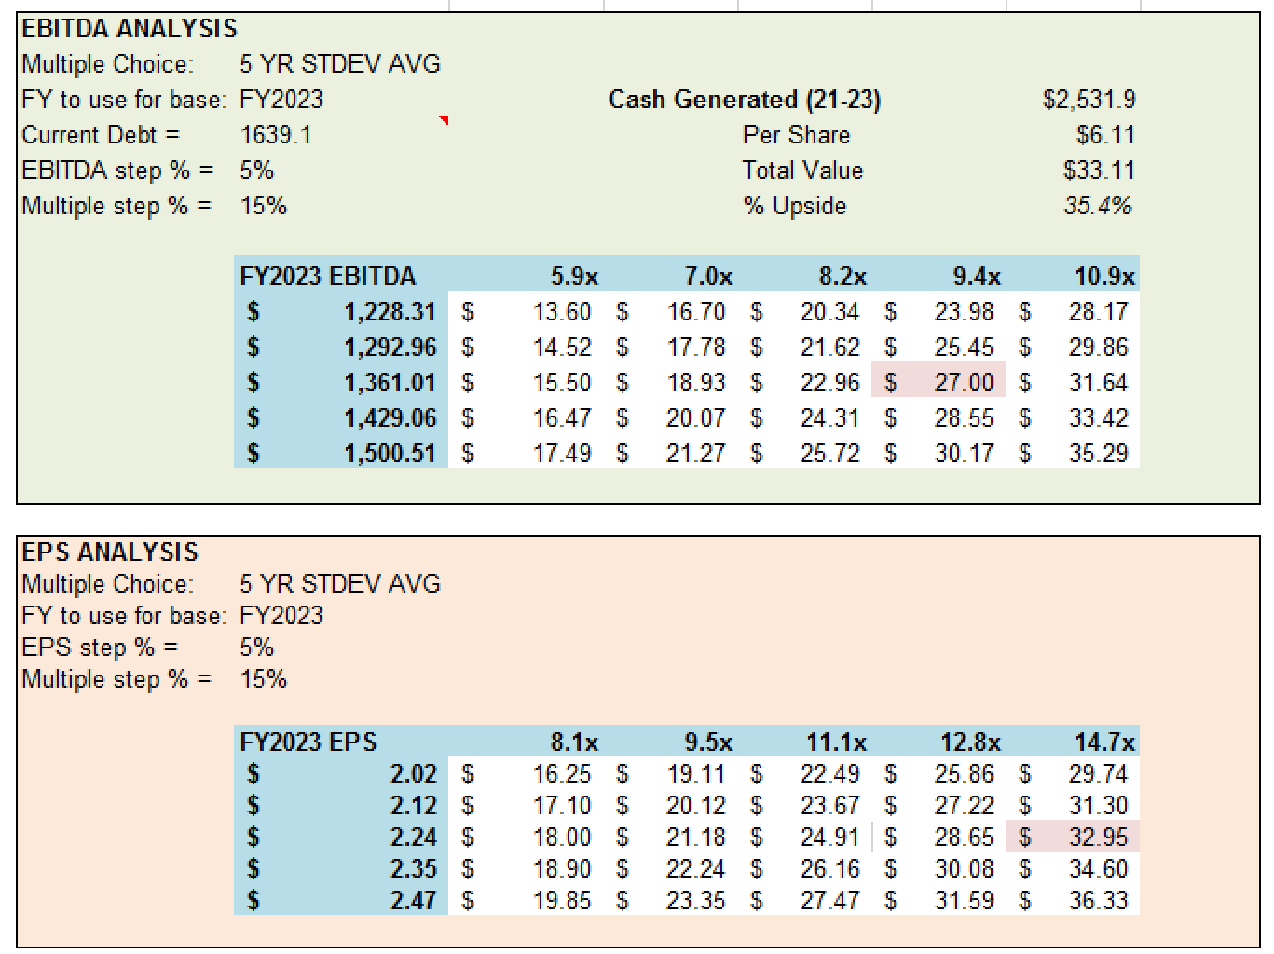
Historical Multiples (cont.)
WU Multiple Analysis:

Slide 35
Sum-of-the-parts (SOTP)
If company has multiple segments:
Find public comps for each of the segments
Apply those multiples to the various segments
Can use precedential transactions as well
Add discount or premium based on business quality vs. peers
Be very careful if there are no/few perfect comps; beware inflated multiples
Sum up the various parts, subtract debt => equity value
LUMN Example

Slide 36
Private Market Value
What would this company be worth if it were sold today?
Look for precedential transactions
Either apply those multiples to segments or whole company
Add discount or premium based on business quality vs. peer
Understand where you are in the cycle and when the deals were completed
Again, be very careful if there are no/few perfect comps; beware inflated multiples
Understand differences that stem from:
Margins
Returns
Growth profile
Geographic exposures
Where the stock is traded
Size and scale
Strategic vs. private equity acquirer

Slide 37
Combining Valuation Techniques
Triangulate value
Again, what you want is multiple metrics that suggest undervaluation
If one doesn’t scream cheap=> not necessarily a deal breaker
Make sure you are consistent in your assumptions across techniques
Use the DCF to test your assumptions:
What is the current stock price implying about growth/margins?
Is that reasonable or unreasonable?
Too conservative => you miss opportunities
Too bullish => you LOSE money
First rule is don’t lose money
Demand a sufficient margin of safety for the risk you are taking
Make sure you have a contrarian thesis on why the market is wrong at the current valuation

Slide 38
PEOPLE

Slide 39
Understanding the People
This is a topic I covered in depth in my Applied Value Investing presentation
Let me know if you want the slides or my personal management scorecard
Major things to consider:
Have to assess prior capital allocation
M&A, buybacks, dividends, divestitures, R&D spend, CAPEX
Read the proxy to understand incentives
ST and LT compensation: what metrics do they use?
Payout in a change in control scenario
Board and management red flags
Does compensation feel excessive?
Does management hit the goals and targets it sets out?
How long they have been there and previous experience
How have financial results and stock price performance been over time?
Be skeptical but make a call on management: friend, foe or neutral

Slide 40
Poll # 6
Which is the most important of the three components of ESG?
Environmental
Social
Governance

Slide 41
ESG (Environmental, Social, Governance)
But wait, how does ESG fit?
There is no good E & S without good G
Everything starts with good corporate governance
Good management teams anticipate changes and invest for the long run
Focus on E&S comes from the top but has to be part of the culture
Will be hard to know a lot about ESG in a short period of time
Have to follow a company and an industry for a while
Focus on governance if you are time constrained
Look at Indeed and Glassdoor to get a sense for culture (the S part)
Do they publish an annual CSR or ESG report?
If so, read through it
Ascertaining the E can be tough as well
So many different reporting standards
Do you reward companies that have low scores but are improving?
Tech companies score high on environmental but how about social?
There are some questions I ask myself (next slide)

Slide 42
10 Questions on the E of ESG
If you see a lot of yeses → that is not a good sign
Look for things that stand out as potential negatives
Cheap valuation may not be enough to protect you from these issues
You may question the longevity of the company or the returns
You may wonder if management has done enough
Capital allocation?
Risk management?
No hard and fast rules exactly—this is a red flag analysis
ESG is a hot space so BEWARE greenwashing by companies

Slide 43
PUTTING IT ALL TOGETHER

Slide 44
Risk Factors
Pay special attention to what can cause you to lose money
First and second rule of investing
Be your own short
Create 4-5 short points for why this will not be a good investment
Remember there are lots of ways to lose money (see next page)
Markets are relatively efficient → you better have a good reason to be a contrarian
There are a lot of stocks that are cheap for a reason
What is going to be different going forward?
Would you rather buy Tootsie Roll (TR)?
Approach every investment with skepticism and humility
Look for reasons NOT to recommend/own the stock
Other people appreciate you highlighting the risks
But also try to be optimistic about the future (because stocks do go up over time)
This is a tough balance

Slide 45
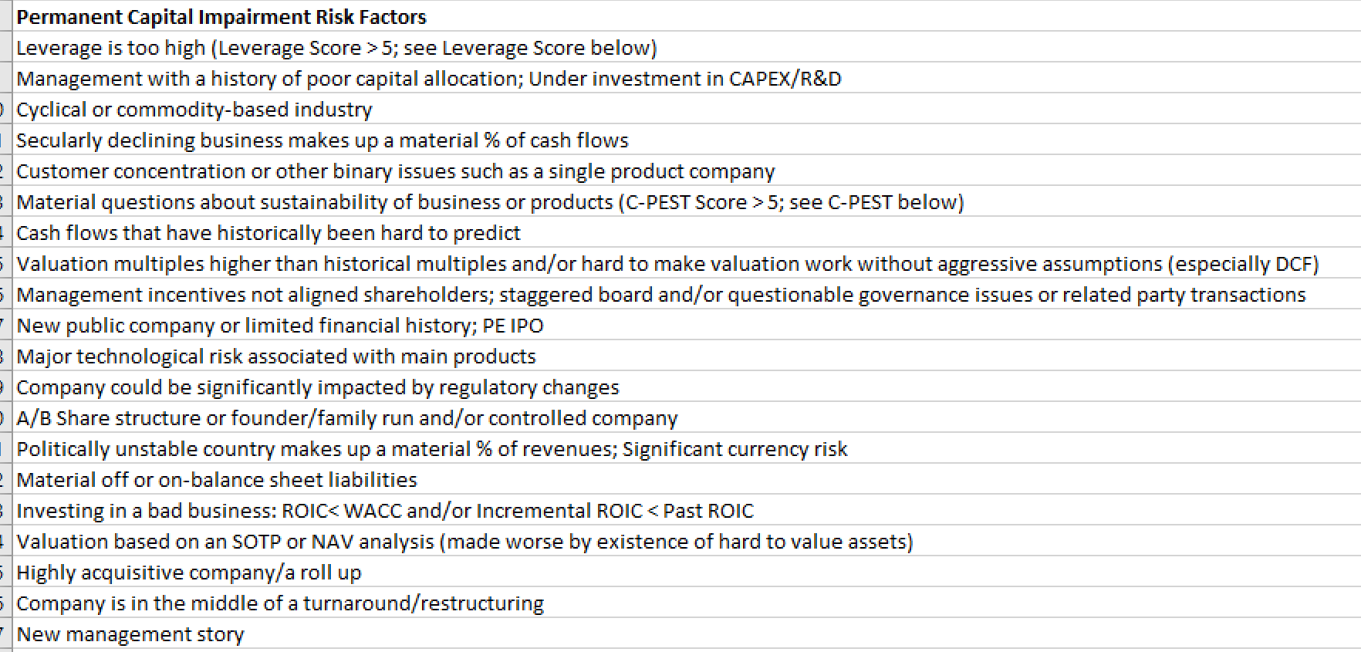
Risk Factors
These are a few very good ways (in our experience) to lose money:

Slide 46
Developing a Contrarian Thesis
Be careful not to parrot the management or sell-side pitch
Have to be different from “consensus”
Write down your narrative for what needs to happen for the stock price to be a lot higher in 3 years
Make sure you have identified the 4 key variables
What is your view on how each will play out over time?
If 10 things have to go right to make money → red flag
Think in terms of base rates
What are you thinking that others aren’t?
What aspects of the company might be underappreciated?
Is it possible to develop an informational edge?
Potential catalysts to value creation

Slide 47
Poll # 7
What is the most important personal characteristic when it comes to being a good investor?
Humility
Optimism
Contrarianism
Skepticism
All of the above

Slide 48
Making a recommendation (?)
First, find a way to highlight the work you have done
Marrying the qualitative and quantitative
Discuss the depth of the process
Remember the expectations associated with the analysis (slides 9 & 10)
Hard/impossible to get conviction in 48 hours (or even a week)
IMHO: don’t make an investment recommendation but do opine on:
Is this a company you would like to own at any price—yes or no?
Does it appear to be trading at a large discount or not?
At what price would it be more interesting?
Is this a business you would be willing to pay up for?
What do you think of the people: friend, foe or neutral?
What further work would you like to do to learn more?
Put yourself in the shoes of a portfolio manager—not just a stock analyst

Slide 49
Other future research avenues
Talk to IR/management
Learn to ask “what if” questions that make people think outside the management script
Contact former employees on LinkedIn
Try to understand management style and company culture
Great way to understand the competitive dynamics
Attend an event from an industry trade show or conference
(Sparingly) talk to other investors who are either long or short the stock
Use expert networks if you have the resources

Slide 50
Other future research avenues
Use the product/service or visit a store/facility
Download the company’s app and try to use it
Sign up for a product demo
Read through relevant filings and calls of other public companies:
Competitors, customers, suppliers
Talk to the IR/management of the competitors
Talk to the IR/management of major customers or suppliers
Find government people to talk to about the company
Go visit the company’s HQ and get a tour

Slide 51
Key Takeaways
Before you start the process, make sure you think about what you are being tasked with
Approach everything with curiosity and humility
It is OK to say “I don’t know” even if you are Charlie Munger
Use checklists to establish your process and don’t be shy about “stealing” from other people’s established processes
Business, Value, People is a good framework for any stock (or business) analysis
Think like a PM—not an analyst
Remember that markets are generally efficient, so you need to develop a true contrarian thesis—and that takes time
Successful investing involves creatively marrying quantitative and qualitative analyses while mitigating your own biases

Slide 52
Q&A
Any questions? Comments? Feedback?
Contact :
bclaremon@covestreetcapital.com

