Slide 1
Compass Minerals (Ticker: CMP)
WHO says that Salt mining is boring?
May 2021

Slide 2
Safe Harbor
The opinions expressed herein are those of Cove Street Capital, LLC and are subject to change without notice. Past performance is not a guarantee or indicator of future results. Consider the investment objectives, risks and expenses before investing.
The information in this presentation should not be considered as a recommendation to buy or sell any particular security and should not be considered as investment advice of any kind. You should not assume that the security discussed in this report is or will be profitable, or references we make in the future will be profitable or equal the performance of the security discussed in this presentation. The report is based on data obtained from sources believed to be reliable but is not guaranteed as being accurate and does not purport to be a complete summary of the available data.
Cove Street Capital, LLC is a registered investment adviser. More information about us is located in our ADV Part 2, which is on our website or upon request; http://covestreetcapital.com/faq/

Slide 3
Firm and Speaker Background
Cove Street Capital
Long-only value investment firm located in L.A.
Concentrated portfolios of micro, small and SMID stocks
3-to-5 year time horizon
Not activists but “suggestivists”
Three investment pillars: Business, Value, People
Presenter: Ben Claremon
Co-Portfolio Manager of Small Cap PLUS strategy (SMID)
About to celebrate 10 years at Cove Street
The Inoculated Investor

Slide 4
Stock Overview
Stock Price: $71.21
MC: $2.372B
EV: $3.51B
Dividend Yield: 4.1%
Low 20s corporate EBITDA %
CAPEX/sales around 7.5%

Slide 5
Business Overview
Salt Segment
High 20% segment EBITDA margins
Owns/operates:
The largest underground rock salt mine in the world in Ontario, Canada (83-year mine life)
NA salt demand: 39M tons of deicing and 10M tons of consumer and industrial
Largest rock salt mine in the UK
Salt mine in Louisiana
Uses: Deicing, water treatment, chemical manufacturing, consumer/professional consumption, other industrial uses
Long term salt price appreciation: 3-4% per year
Can move around based on the prior winters
Great play if you are worried about inflation
Total salt capacity= 16.2M tons
2021 production: 11.5M to 12.3M
Low value, high weight product + high transportation costs = very local business (or access to rail/waterways)
Often only a handful of suppliers selling into municipalities
Places where there is snow and ice cannot operate without de-icing salt
I see this as a company more like the aggregates companies (MLM &VMC) than an ag company, for example

Slide 6
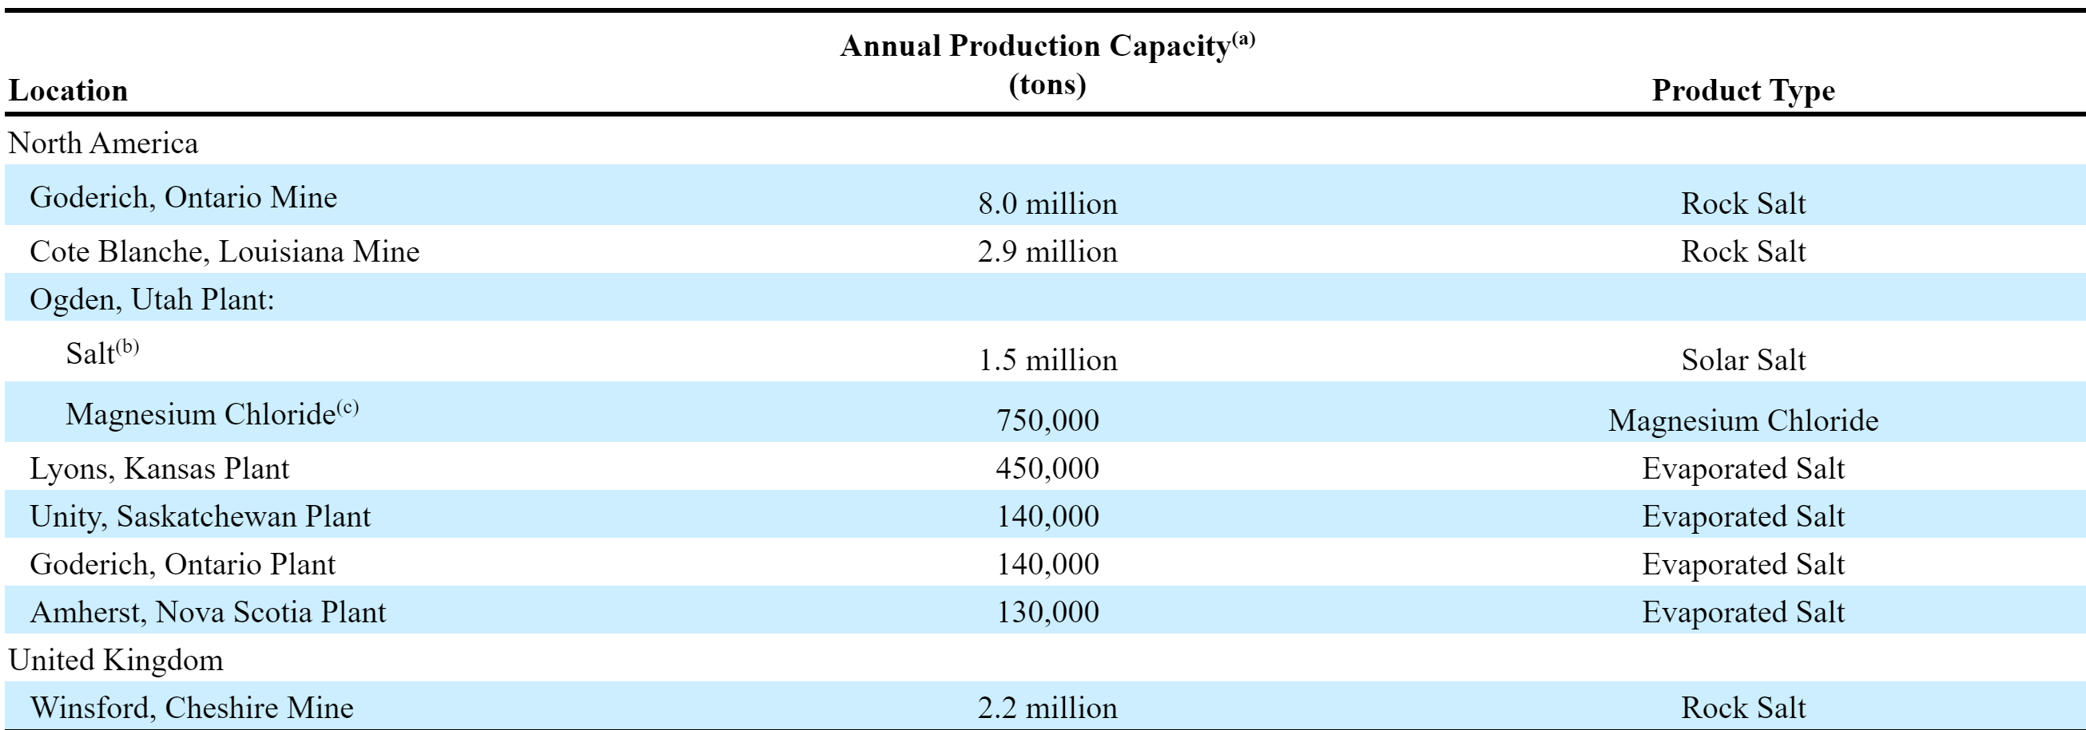
Business Overview (Cont.)

Slide 7
Business Overview
2 Segments
Plant Nutrition
Old management team made a poor acquisition of Produquimica in Brazil
New CEO, Kevin Crutchfield, came in and rightly decided to divest the business
Selling the main asset to ICL for $400M
Water treatment business (sneaky good business) in the process of being sold
Now you have a literal monopoly in the domestic SOP business
Sulfate of potash versus muriate of potash
SOP for high value crops; always trades at a positive spread to MOP due lack of chlorides
Imports from the EU are the only competition
Ogden, UT evaporation ponds: 55K acres
320K tons of solar SOP; 1.5M tons of salt in a typical weather year
2021 Production: 380K tons
Business has not performed great as of late--margins in the high 20s
Need to get the ponds working better to improve margins—think they can get these > 30%

Slide 8
People
New CEO Kevin Crutchfield came in during May 2019
Work as a coal miner before
If he knows anything, it is about how to run a mine
The previous management team had spent hundreds of millions of dollars and literally messed up the mine production at Goderich
Crutchfield has remedied the situation and production and margins are improving
Strike and mine collapse really hurt Goderich
He also has come in and divested non-core assets
B/S leverage has come way down- under 3x by the end of the year
Didn’t have to cut the dividend
Still working to make Goderich and Plant Nutrition even better

Slide 9
Value
Currently trading at around 11x 2021 EBITDA
Why shouldn’t these assets get more of a specialty chemical and aggregates multiple?
MLM and VMC trade at over 18x
FMC and CTVA trade at over 13x
A little hard to DCF this company because of the weather
We see these as irreplaceable assets with the salt mine being a true infrastructure asset
The company has not gotten the love because of poor management and too much leverage
Both of those have been remedied to a large extent
We think the PMV value of the company is in the mid-$90s
13x normalized EBITDA
Could go a lot higher if Crutchfield can execute on margins and growth initiatives
Salt mine shut down in the South and CMP has been taking share
We think there would be a lot of buyers for Plant Nutrition (CEO is no an ag guy)

Slide 10
Summary
Great assets that have long lives, generate cash, produce high margins and are very well competitively positioned
New CEO has come in and improved capital allocation and margins
Assets like these could fetch very high values in the private market
Plenty of room for improvement from here
Probably not a multi-bagger from here but future returns could be very attractive relative to an expensive market
In the meantime, you get a 4% yield and $100M+ in FCF
There is a salt asset for sale as part of a divestiture that CMP may be the only true bidder for

Slide 11
Questions and Contact Info
Q&A
Contact:
Website: www.covestreetcapital.com
Email: bclaremon@covestreetcapital.com
Follow me on Twitter: InoculatedInves
https://twitter.com/InoculatedInves

